Slide 1
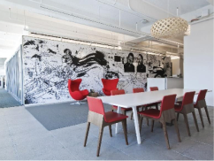





C team
- Jim, Cho, Tom, Lina, Missy
2 Week presentation
Qualcomm Institute
/19

Slide 2
2 week presentation
CONTENTS
C team
Sequence
Diagram
ER
Diagram
Web
Client
Application
Qualcomm Institute
/19

Slide 3
Sequence Diagram
C team
Qualcomm Institute
/19
Notes:
- We already presented our sequence diagram in last weekly meeting, and we got some feedback so today just i will talk about change points of sequence diagram.
지난 발표에 해서 change point에 대해서

Slide 4
Change point of Sequence Diagram
C team
Delete duplicate information
Change authentication method in forgotten password situation
Change expression
/19
Notes:
we had different authentication method on forgotten password and registration but now they are same way to use authentication code
비밀번호 변경 방법이 이메일 인증에서 인증 코드로 바뀜
영어 표현 변경
중복 설명 제거
어떻게 변했는지 확인해 보자 (인증 코드 사용하는것으로 바꼈다)

Slide 5
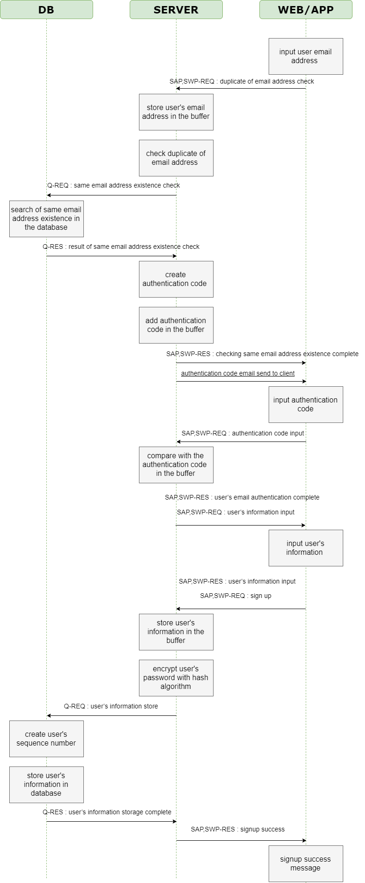
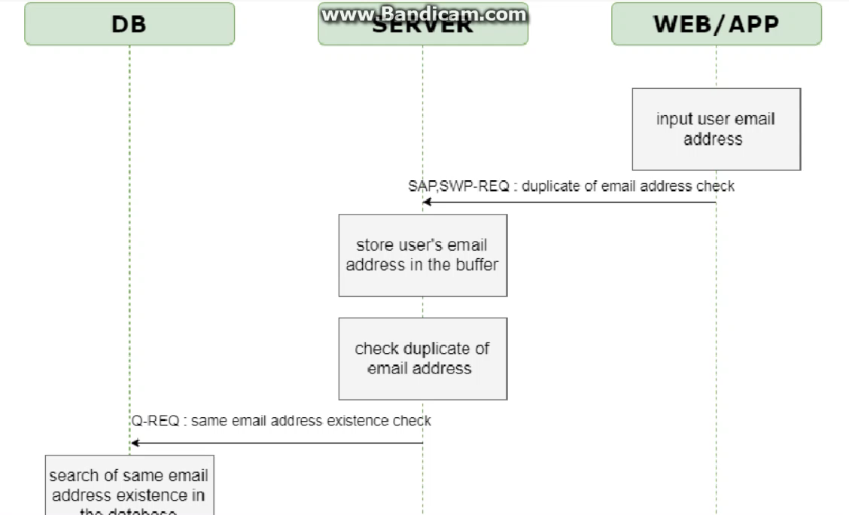
Registration Sequence Diagram
C team
/19

Slide 6
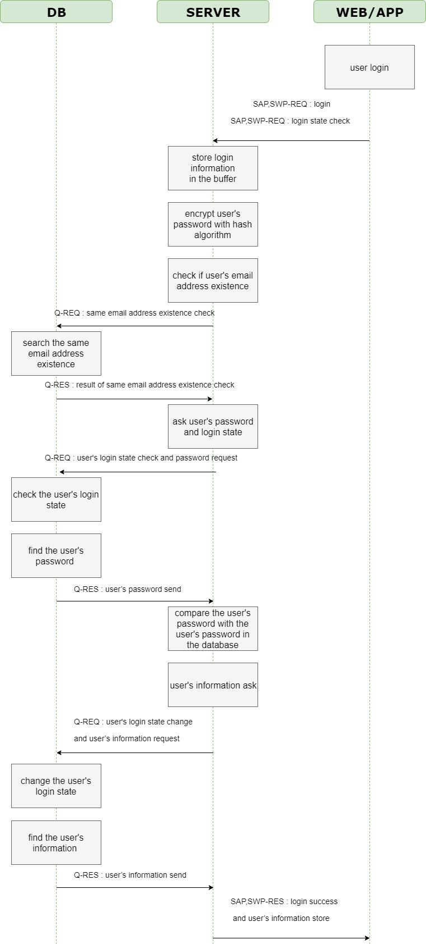
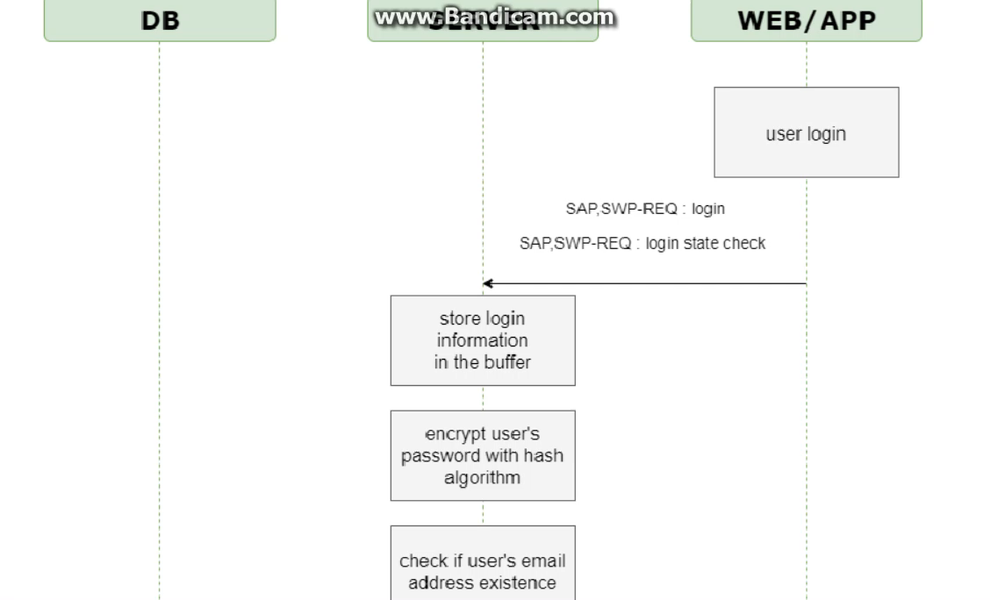
Sign-in Sequence Diagram
C team
/19

Slide 7
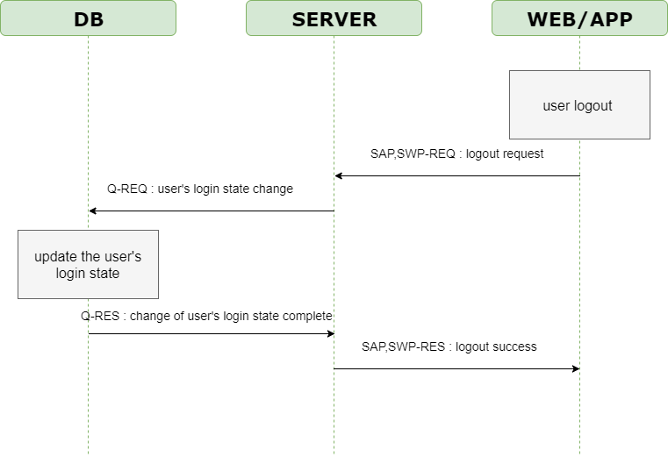
Sign-out Sequence Diagram
C team
/19

Slide 8
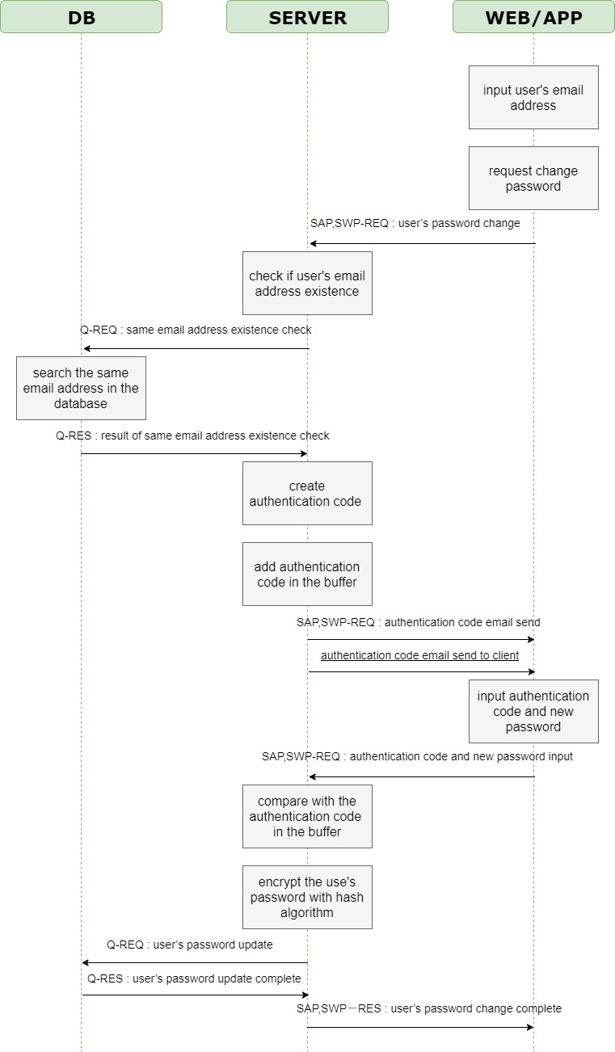
Forgotten password Sequence Diagram
C team
/19
Notes:
- There are not many changes. It is similar to last meeting.

Slide 9
ER Diagram
C team
Qualcomm Institute
/19

Slide 10
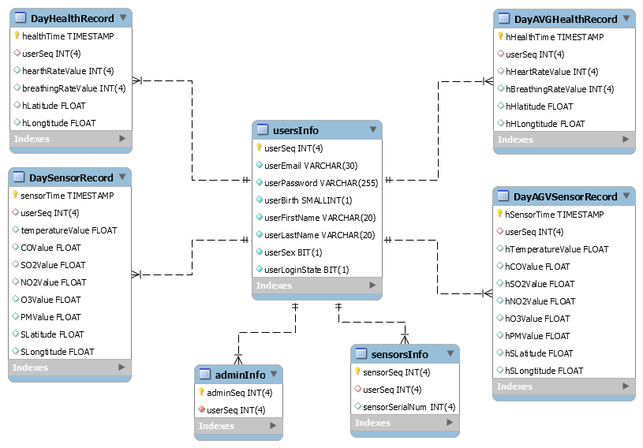
ER Diagram
C team
/19
Notes:
To prevent duplicate logins
We store sensor date during a day.
After a day, we will average this record and save it in another tables. So they have same structures.
This table has an average daily record.

Slide 11
Web Client
C team
Qualcomm Institute
/19

Slide 12
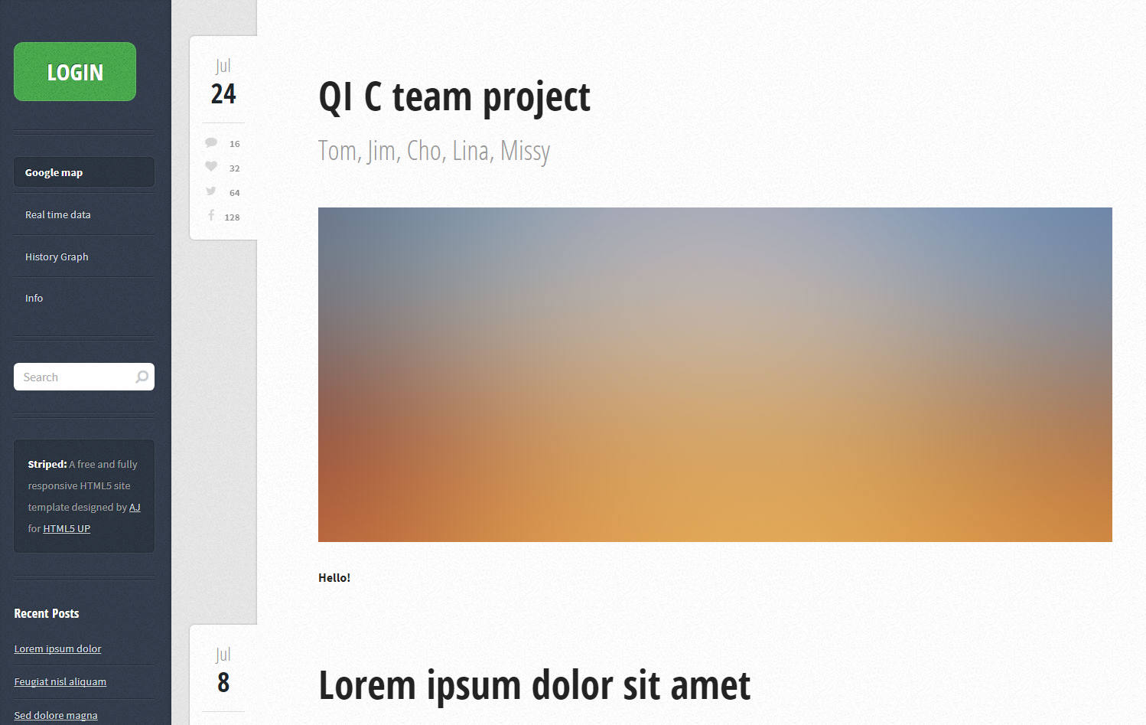
Web client - template
C team
/19
Notes:
- You can see easy at a glance

Slide 13
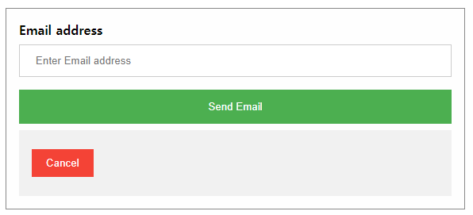
Web client – function(1) Sign up
C team
Before input the user’s information
/19
Notes:
- You want to sign up ,Input your email address and you should verify through authentication code in the email.
- we tried to send email to client but we didn't do yet
we have not done it yet
Maybe next weekly meeting we can show you this function.

Slide 14
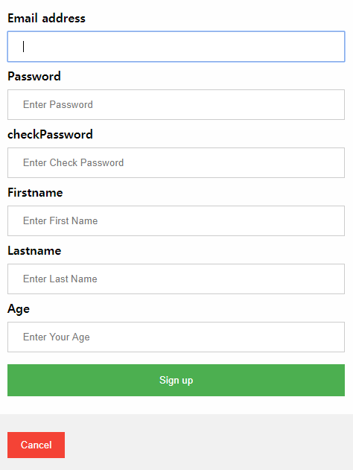
Web client – function(1) Sign up
C team
Encrypt with hash algorithm
Check password
+ Duplicate email address check
+ Add another items
/19
Notes:
After user authentication, user need to input their information
when you click the sign up button, we check entered everything if you don’t do that , you can show the message
If password and check password are different, a message says wrong password.
We added to encrypt user’s password with hash algorithm

Slide 15
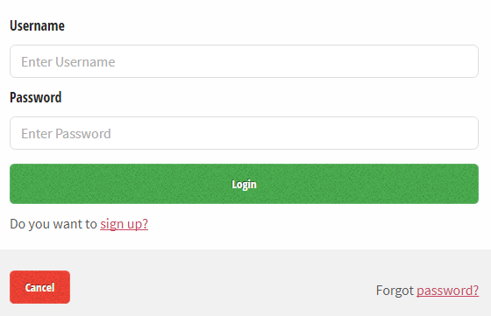
Web client – function(2) Login
C team
- Check correct password
/19
Notes:
- If you input wrong password, show the message that wrong password.
- Let's see how it works

Slide 16
Web client
C team
Web Client
/19
Notes:
- Let's see how it works

Slide 17
Application UI
C team
Qualcomm Institute
/19

Slide 18
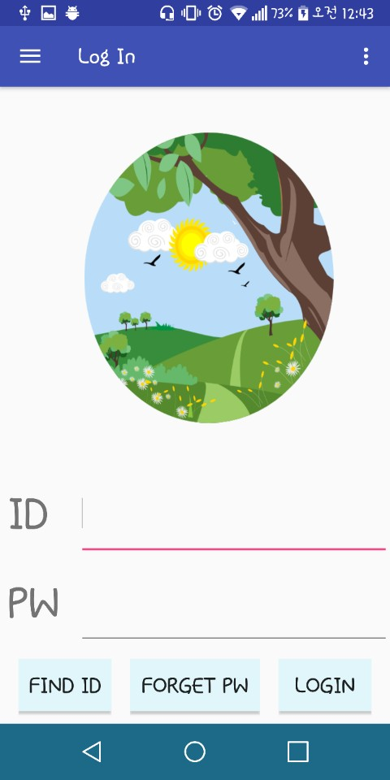
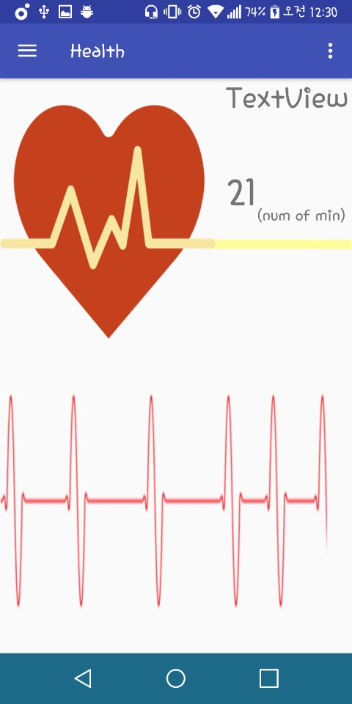
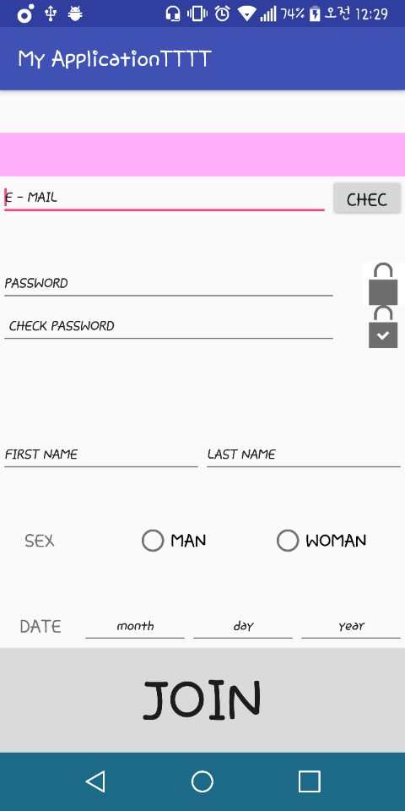
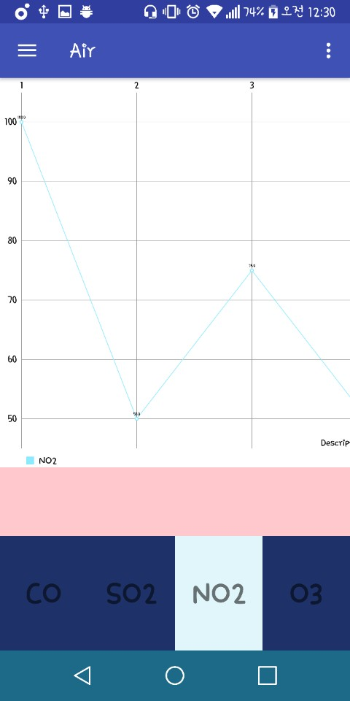
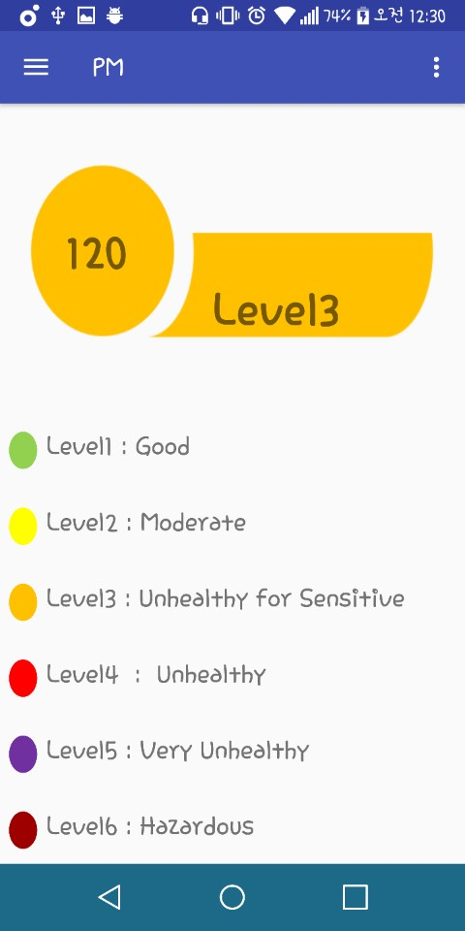
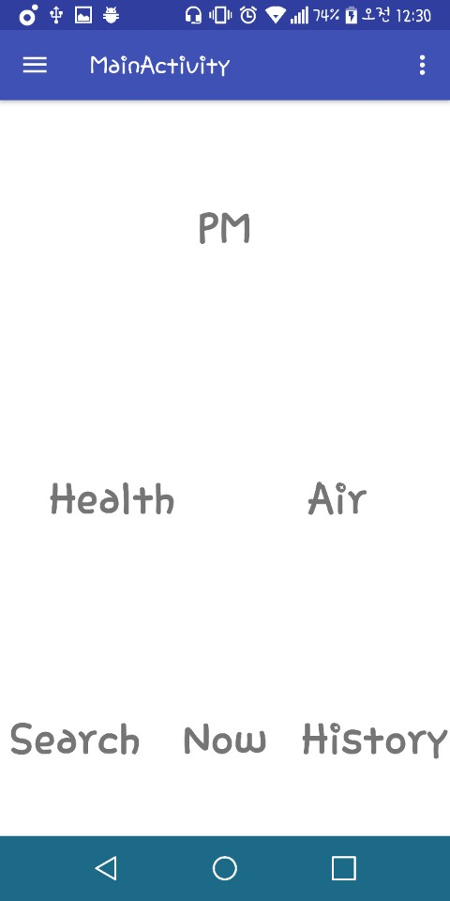
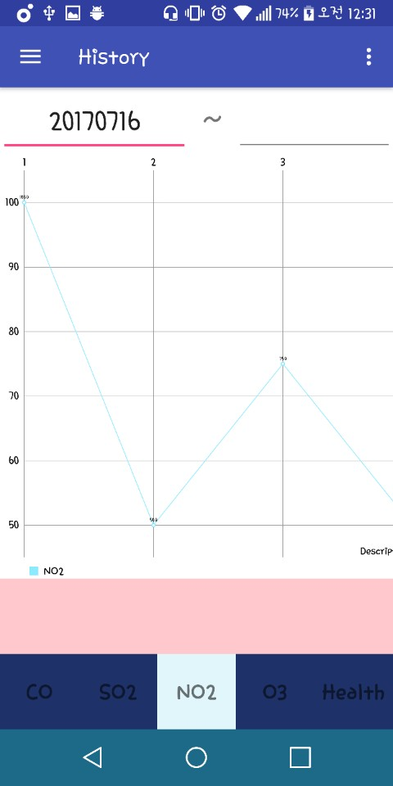
Application UI
C team
18/19

Slide 19
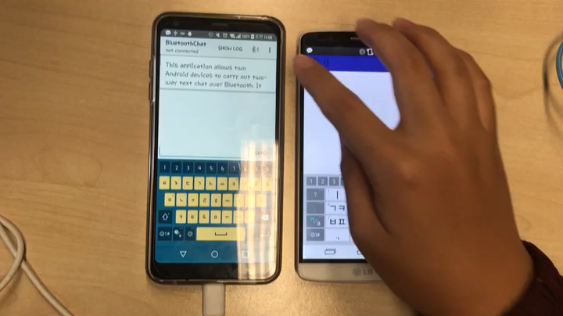
Application UI
C team
19/19

Slide 20
Thank you
Qualcomm Institute

